Slide 1
Max Minesweeper
By Max Kofford

Slide 2
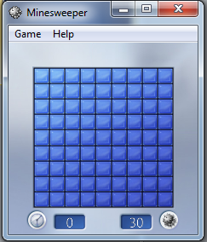
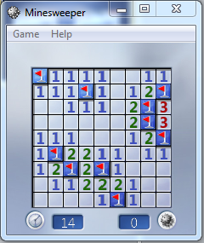
What is Minesweeper?

Slide 3
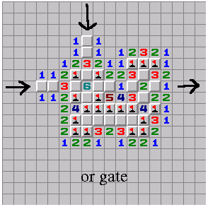
Can a solver be made for it?
Kaye, Richard (2000). "Minesweeper is NP-complete". Mathematical Intelligencer
http://sed.free.fr/complex/mines.html

Slide 4
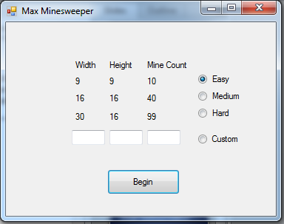
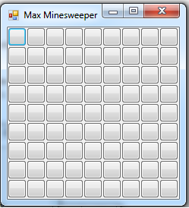
First step: Create Minesweeper

Slide 5

Second step: The encoding.
(A ^ !B ^ !C ^ !D ^ !E ^ !F ^ !G ^ !H) V
(!A ^ B ^ !C ^ !D ^ !E ^ !F ^ !G ^ !H) V
(!A ^ !B ^ C ^ !D ^ !E ^ !F ^ !G ^ !H) V
(!A ^ !B ^ !C ^ D ^ !E ^ !F ^ !G ^ !H) V
(!A ^ !B ^ !C ^ !D ^ E ^ !F ^ !G ^ !H) V
(!A ^ !B ^ !C ^ !D ^ !E ^ F ^ !G ^ !H) V
(!A ^ !B ^ !C ^ !D ^ !E ^ !F ^ G ^ !H) V
(!A ^ !B ^ !C ^ !D ^ !E ^ !F ^ !G ^ H) V

Slide 6

Encoding cont.
(A ^ B ^ !C ^ !D ^ !E ^ !F ^ !G ^ !H) V
(A ^ !B ^ C ^ !D ^ !E ^ !F ^ !G ^ !H) V
(A ^ !B ^ C ^ !D ^ !E ^ !F ^ !G ^ !H) V
(A ^ !B ^ !C ^ D ^ !E ^ !F ^ !G ^ !H) V
(A ^ !B ^ !C ^ !D ^ E ^ !F ^ !G ^ !H) V
(A ^ !B ^ !C ^ !D ^ !E ^ F ^ !G ^ !H) V
(A ^ !B ^ !C ^ !D ^ !E ^ !F ^ G ^ !H) V
(A ^ !B ^ !C ^ !D ^ !E ^ !F ^ !G ^ H) V
………………………….
Every possible combination of n choose k
Where n = the number – nearby mines and k = the number of nearby empty squares.
Results in: 9 combinations for 1
28 for 2
56 for 3
Big Blowup !!!!!!

Slide 7
What do we do with the formula?
2 different encodings using the formula:
1. Generate all possible solutions
Any variables that don’t change among the solutions is a known value.
- Very Slow and breaking early may result in more guessing and failure.
2. Check each square using foreach
- 2 checks per variable
Any variable that the checker returns unsat for is a known value
Much faster and less guesses (more often succeeds).

Slide 8
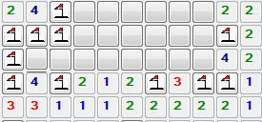
What about guesses?
Guess randomly
Guess near a found value.
Guess near a found value with the lowest number – nearby mines / nearby empty squares.

Slide 9
Demo Time!

